Slide 1

Easy learning academy
Enjoy a personalized, fun, and interactive learning process and Make your basic strong.

Slide 2

Supervised by
DR. RAZIB HAYAT KHAN Assistant Professor , Computer Science razib.khan@aiub.edu
Faculty of Science and Technology (FST)
American International University-Bangladesh (AIUB)

Slide 3



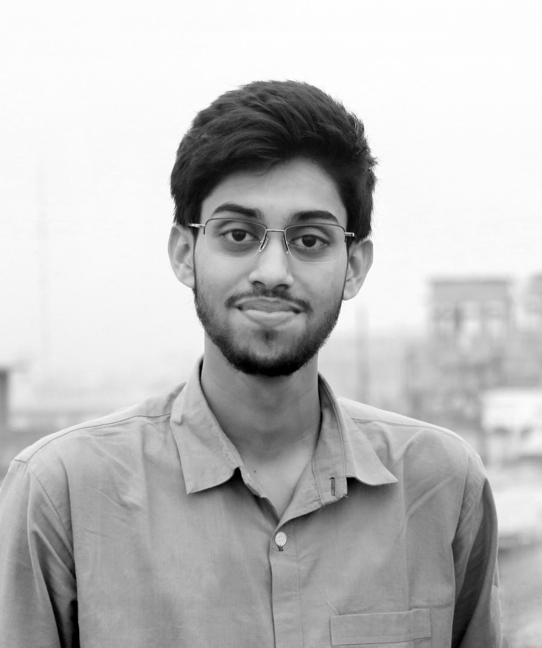
Group members
MOHAMMED JAMSHED ALAM
19-41727-3
MD. MAHIM TALUKDER 19-41621-3
ARPITA DATTA
19-41608-3
SAYED SYFUZZAMAN
19-41718-3

Slide 4
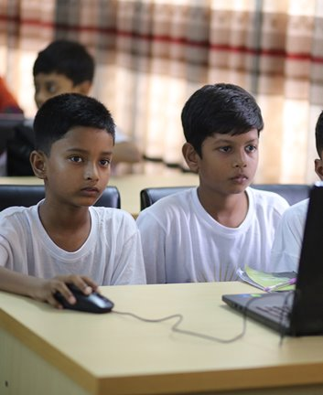
Project description
Build a platform where someone can take their first steps of learning programming.
Give interesting learning material to learn programming on their own.
The goal of our project is to help anyone who wishes to learn programming.
There will be different types of content such as interactive videos, animations, games etc.
Inform everyone the importance of programming and how programming affects our day-to-day life.
We want the next generation of programmers to be better than us, to do better work than us, to reach higher level than us.

Slide 5

Our Target
Target Audience: Age group 14-18
People who are beginner in programming
Teach the importance of programming in their future career

Slide 6

need, problem or opportunity
Problems
Students have the misconception that they have to memorize programming
Humans learn 2 times faster with the help of visualizing
Our Opportunities
Make programming easier to learn with the help of visualizing
Programming games which provide an entertaining way of learning

Slide 7

Project purpose and functionalities
Helps to learn programming
Remove the fear of programming from the minds of young learners
One can attend quiz, complete tasks & achievements, watch videos etc.

Slide 8
THANKS FOR WATCHING!

